Slide 1
Note for ARIA
Express characteristics or relationships to an object.
ARIA takes precedence over native HTML.
Aria-labelledby takes precedence over aria-label

Slide 2
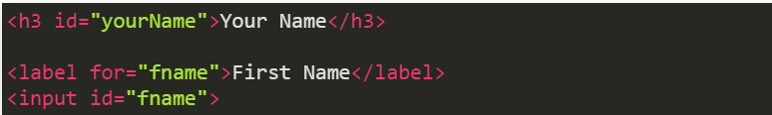
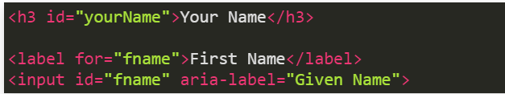
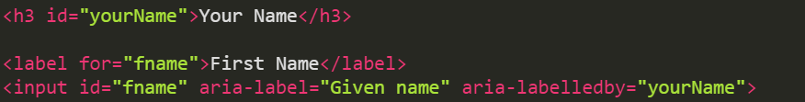
Accessible name precedence
In the following code example, the Accessible Name for the input field?
First Name
Given Name
Your Name

Slide 3
Week 10 - Accessible JavaScript
CST8914 - Accessible by Design

Slide 4
Weekly Outcome
Explain JavaScript influences accessibility
Explain event triggers that work for both keyboard and mouse users
Implement JavaScript practices of accessible focus management
Implement JavaScript practices of accessible state management
Address the accessibility limitations of single-page applications.

Slide 5
Lesson Overview
In the following lesson, we will explore topics of accessible JavaScript:
JavaScript and accessibility
JavaScript event triggers
Focus management in JavaScript
State management in JavaScript
Single Page Applications
Notes:
Explore the myth of JavaScripts affect on accessibility
Dive into accessible JavaScript patterns
Gain awareness of single page applications shortcomings

Slide 6
JavaScript and Accessibility
How does JavaScript impact accessibility and how to properly use it.

Slide 7
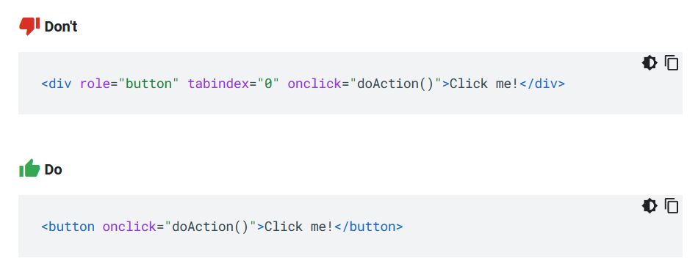
Use of native HTML elements is the default!
Don’t use custom elements except needed

Slide 8
The myth
Developers tend to think that JavaScript has no impact on the accessibility of pages
Common myths:
“It is code and not mark up so how could it?”
“Semantic HTML takes care of it all”
“JavaScript frameworks come with all accessibility baked in”

Slide 9

The truth
JavaScript has a MAJOR impact on the accessibility of web applications and how they function and behave
From component level changes or actions to full on frameworks such as React or Angular

Slide 10
Common misuses of JavaScript
Where to set the keyboard focus not implemented (Example: Modal Dialog not receiving focus - (activate click here))
Event triggers with HTML elements (Mouse only, without keyboard) (Example: Tabs are navigable with mouse only)
With user interaction, the state (selected, expanded etc) not implemented (Example: Active tab identified visually only)
Rendering chunks of HTML through JavaScript with no semantic structure
Thinking semantic/native HTML isn’t needed and JavaScript can do it all

Slide 11
References in Accessible JavaScript
JavaScript - Google, Accessibility, Web.Dev
Keyboard-navigable JavaScript Widgets, Mozilla.org

Slide 12
JavaScript Events & Non-native controls

Slide 13
Events (or Event Triggers)
An Event refers to an action or occurrence that happens in a web page.
Example of event triggers:
clicking a button,
pressing a key on the keyboard,
moving the mouse over an element
Event handling refers to the process of capturing and responding to events
i.e., when the user clicks a button, a function is executed to change the text of a paragraph.

Slide 14
Event handlers: mouse & keyboard
Use of both keyboard-specific and mouse-specific events with code that has a scripting function associated with an event.
Use...(mouse event) | ...with (keyboard event)
mousedown | keydown
mouseup | keyup
click | keypress ^{Deprecated}
mouseover | focus
mouseout | blur
Read more SCR20: Using both keyboard and other device-specific functions, W3C
Notes:
https://www.w3.org/WAI/WCAG21/Techniques/client-side-script/SCR20.html
[1] Although click is in principle a mouse event handler, most HTML and XHTML user agents also process this event when a native HTML control (e.g. a button or a link) is activated, regardless of whether it was activated with the mouse or the keyboard. In practice, therefore, it is not necessary to duplicate this event when adding handlers to natively focusable HTML elements.
[2] Since the keypress event handler reacts to any key, the event handler function should check first to ensure the Enter key was pressed before proceeding to handle the event. Otherwise, the event handler will run each time the user presses any key, even the tab key to leave the control, and this is usually not desirable.
[3] Some mouse-specific functions (such as dblclick and mousemove) do not have a corresponding keyboard-specific function. This means that some functions may need to be implemented differently for each device (for example, including a series of buttons to execute, via keyboard, the equivalent mouse-specific functions implemented).

Slide 15
Example: Focus and mouseover
// HTML
<button onfocus="myFunction()" onmouseover="myFunction()">Action!</button>
<p id="demo"></p>
// JS
<script>
function myFunction() {
document.getElementById("demo").innerHTML = "Hello World";
}
</script>

Slide 16
Events handling in non-semantic elements
Semantic elements:
<button>, <a>, <input> have built-in accessibility features.
Both mouse AND keyboard events are supported by default and therefore screen readers
Non-semantic elements :
<div> and <span> do not have accessibility built-in.
Relies on CSS and JavaScript to style to add the support for the keyboard & screen reader

Slide 17
Example: Semantic Button vs. Custom Button
Keyboard interaction (from pattern): When the button has focus, Space: Activates the button. Enter: Activates the button. The custom button will need to: 1) be added in the tab order, and 2) be activated using the ENTER and SPACE keys.
Semantic button
Non-Semantic button/ custom button
HTML
// One line of coode. All built-in!
<button>Print!</button>
HTML
// Role to add semantic to div. tabindex="0" to include it to the natural tab order
<div id="button“ role=“button” tabindex="0">Print</div>
JavaScript
//add enter and space keys support ENTER key (13) or SPACE key (32)
var button = document.getElementById('button');
button.addEventListener('keydown', function(e) {
if (e.keyCode === 13 || e.keyCode === 32) {
e.preventDefault();
this.click();
}
});
Read more Technique: Keyboard operable custom controls, Harvard University

Slide 18
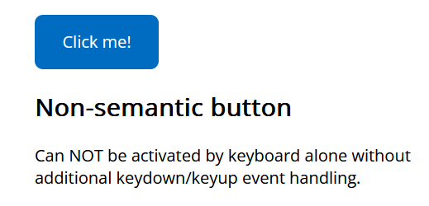
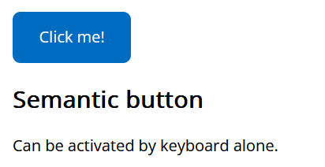
Example: Accessible JavaScript – Button (React)
Code Pen: https://codepen.io/web-dot-dev/pen/bGKOrLj

Slide 19


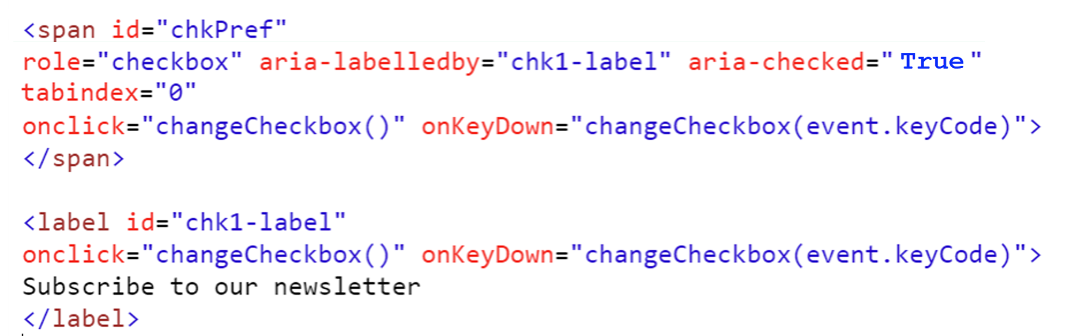
Non-semantic checkbox
Events and Event handlers
Keyboard interaction
Space key: Activates the checkbox
JavaScript
Event handlers onclick - Handel mouse clicks on checkbox & label
onKeyDown - Handle the Space key pressed
e.keyCode == 32 - Spacebar key code
Complete code on ARIA: checkbox role – MDN https://developer.mozilla.org/en-US/docs/Web/Accessibility/ARIA/Roles/checkbox_role
Notes:
The JavaScript use the events on keydown and onclick to listen to the space bar and mouse click and switch the aria-check state

Slide 20
JavaScript concepts
Access the DOM element: Methods like getElementById, querySelector, or querySelectorAll .
Example: https://www.w3schools.com/jsref/met_document_getelementbyid.asp document.getElementById("demo").innerHTML = "Hello World";
Use element.focus() to set focus: Do not use createEvent(), initEvent() and dispatchEvent() to send focus to an element.
Use onfocus to track the current focus: Don't assume that all focus changes will come via key and mouse events: assistive technologies such as screen readers can set the focus to any focusable element. Track focus using onfocus and onblur instead.

Slide 21
Focus management in JavaScript

Slide 22
Focus management in JavaScript
It involves controlling and manipulating the focus of elements on a web page,
For screen reader and keyboard only users, it can be extremely difficult to navigate without proper focus management.
Techniques for focus management in JavaScript:
Tabindex (-1)
Roving tabindex (-1, 0)
aria-activedesendent

Slide 23
Technique 1: Use tabindex (-1)
Add tabindex="-1" to a static element to make it programmatically focusable and use JavaScript to move the focus to the element.

Slide 24
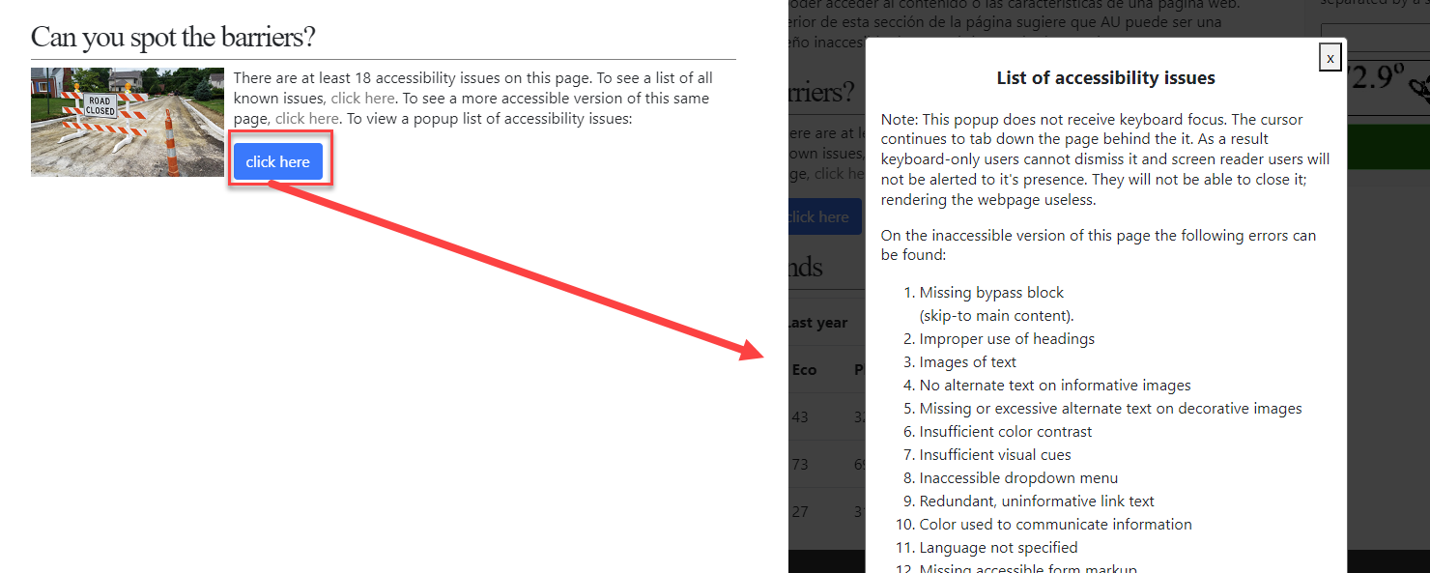
Example: Use tabindex (-1) in modal dialog (1 of 3)
Use case:
On the accessible university website, when the trigger element “click here” is activated.
The modal does not receive keyboard focus
The elements on the background page receive focus.
Demo on inaccessible modal https://youtu.be/fiHBQ1znfDI

Slide 25
Example: Use tabindex (-1) in modal dialog (2 of 3)
Modal Dialog Keyboard Interaction Design Pattern
When a modal opens, focus should be placed at one of two locations:
Around the ENTIRE modal itself
On the first heading that is inside the modal.
This way when it opens, a users can simply navigate throughout the modal and continue moving forward.

Slide 26
Example: Use tabindex (-1) in modal dialog (3 of 3)
To perform this focus change, we use tabindex=”-1” on either modal body OR the first heading inside the modal
Tabindex=”-1” allows for JavaScript specific focus to be placed on an item and nothing else. (Different than tabindex=”0” which brings it into the natural focus order)
Let’s take a look at an accessible example: https://codepen.io/vavroom/pen/NpRLzE

Slide 27
Technique 2: Roving tabindex (-1, 0)
Use JavaScript to move focus in response to the user's keyboard input (key events)
programmatically apply focus to the new/active element,
update the tabindex of the focused element to "0", and
update the tabindex of the previously focused element to "-1".
This technique is typically used when you have a group of elements that should logically be navigated in a specific order, like a menu, a set of tabs, or a carousel.
Roving tabindex (video, 13 min)

Slide 28
Example: Roving tabindex in radio group (1 of 3)
This method sets the tabindex for each tree item.
Roving tabindex logic
programmatically apply focus to the new/active element,
update the tabindex of the focused element to "0", and
update the tabindex of the previously focused element to "-1".
//listens to key presses
*** key presses for Arrow Up, Arrow Down, Enter, and Escape
// Roving tabindex
if (item === NewTreeElement) {
item.tabIndex = 0;
NewTreeElement.focus();
} else {
item.tabIndex = -1;
}
Read more: https://developer.mozilla.org/en-US/docs/Web/Accessibility/Keyboard-navigable_JavaScript_widgets#managing_focus_inside_groups
Notes:
if (item === newMenuitem) {
item.tabIndex = 0;
newMenuitem.focus();
} else {
item.tabIndex = -1;
}

Slide 29
Example: Roving tabindex in radio group (1 of 3)
Radio group example
Radio group on pencode
https://developer.mozilla.org/en-US/docs/Web/Accessibility/Keyboard-navigable_JavaScript_widgets
// Set the radio button's tabIndex to -1 and aria-checked to 'false'
rb.tabIndex = -1;
rb.setAttribute('aria-checked', 'false');
// Add event listeners for keydown, click, focus, and blur events
rb.addEventListener('keydown', this.handleKeydown.bind(this));
rb.addEventListener('click', this.handleClick.bind(this));
rb.addEventListener('focus', this.handleFocus.bind(this));
rb.addEventListener('blur', this.handleBlur.bind(this));
// Push the radio button into the radioButtons array
this.radioButtons.push(rb);
// If the firstRadioButton is not set, set it to the current radio button
if (!this.firstRadioButton) {
this.firstRadioButton = rb;
}
// Set the lastRadioButton to the current radio button in each iteration
this.lastRadioButton = rb;
}
// Set the tabIndex of the firstRadioButton to 0
this.firstRadioButton.tabIndex = 0;
Notes:
// Get all radio buttons within the groupNode
var rbs = this.groupNode.querySelectorAll('[role=radio]');
// Loop through each radio button
for (var i = 0; i < rbs.length; i++) {
// Get the current radio button
var rb = rbs[i];
// Set the radio button's tabIndex to -1 and aria-checked to 'false'
rb.tabIndex = -1;
rb.setAttribute('aria-checked', 'false');
// Add event listeners for keydown, click, focus, and blur events
rb.addEventListener('keydown', this.handleKeydown.bind(this));
rb.addEventListener('click', this.handleClick.bind(this));
rb.addEventListener('focus', this.handleFocus.bind(this));
rb.addEventListener('blur', this.handleBlur.bind(this));
// Push the radio button into the radioButtons array
this.radioButtons.push(rb);
// If the firstRadioButton is not set, set it to the current radio button
if (!this.firstRadioButton) {
this.firstRadioButton = rb;
}
// Set the lastRadioButton to the current radio button in each iteration
this.lastRadioButton = rb;
}
// Set the tabIndex of the firstRadioButton to 0
this.firstRadioButton.tabIndex = 0;

Slide 30
More Examples
https://www.freecodecamp.org/news/html-roving-tabindex-attribute-explained-with-examples/
https://www.w3.org/WAI/ARIA/apg/patterns/radio/examples/radio/

Slide 31

Time to check your knowledge!
Let’s see how many key concepts from “Focus management – roving technique” you recall!
Lab 10 Question 1

Slide 32
Technique 3: aria-activedesendent
In situations where you have a widget or component with a dynamic interface that needs to change focus within a container.
The aria-activedescendant attribute is added to the container element, and its value is set to the id of the currently active or focused option within the container.
JavaScript is used to manage the focus within the container.
Aria-activedescendent (video start min 5)

Slide 33
Example: aria-activedesendent
Radio Group Pattern
Radio Group Example Using Roving tabindex
Radio Group Example Using aria-activedescendant

Slide 34
State management in JavaScript

Slide 35
Managing state of components
Another area where JavaScript is critical to accessibility is state management, or when a component or page's current visualstate is relayed to a low-vision, blind, or deafblind assistive technology user.
The state of a component is managed through a combination of JavaScript and ARIA
Two great examples of this are:
Expand/collapse sections
Pressed state of button

Slide 36
Example: State Management in checkbox
Example:
State management in checkbox
aria-checked=“true”
aria-checked=“false”
Codepen: https://codepen.io/pen?editors=1010
toggleCheckbox() {
if (this.domNode.getAttribute('aria-checked') === 'true') {
this.domNode.setAttribute('aria-checked', 'false');
} else {
this.domNode.setAttribute('aria-checked', 'true');
}
}

Slide 37
Managing state: expand/collapse
If a user has to expand a section of the page to reveal more content below, then the state of that toggle must be announced
We do this using aria-expanded=”true/false” depending on the state.
Example: https://codepen.io/web-dot-dev/pen/oNyJeQZ

Slide 38
Managing state: pressed state
Let’s say we have a user that is currently wanting to select an item in a list of buttons
Visibly the buttons may turn different colors to show that has been “pressed” but how does a user know which one is currently in play?
aria-pressed=”true/false” allows a user to know which item has currently be pressed.
Example: https://codepen.io/web-dot-dev/pen/jOKXLyv
Example of Tree https://files.paciellogroup.com/training/WWW2012/samples/Samples/aria/tree/index.html#

Slide 39
Time to check your knowledge!
Let’s see how many key concepts from “State management” you recall!
Lab 10 Question 2

Slide 40
Complete example
Non-semantic checkbox element using CSS and JavaScript to handle the checked or unchecked status of the element.
Keyboard interaction
Space key: Activates the checkbox
JavaScript
Event handlers onclick - Handel mouse clicks on checkbox & label
onKeyDown - Handle the Space key pressed
e.keyCode == 32 - Spacebar key code
Change state dynamically /change the value of the aria-checked attribute for keyboard users
If {the spacebar key} = pressed {aria-check} = true
Else {aria-check} = false
Complete code on ARIA: checkbox role – MDN https://developer.mozilla.org/en-US/docs/Web/Accessibility/ARIA/Roles/checkbox_role
Notes:
The JavaScript use the events on keydown and onclick to listen to the space bar and mouse click and switch the aria-check state

Slide 41
Single Page Applications (SPA)

Slide 42
What is a Single Page Application?
An SPA (Single-page application) is a web app implementation that loads only a single web document, and then updates the body content of that single document via JavaScript APIs such as XMLHttpRequest and Fetch when different content is to be shown.
Example of accessible Single Page App
Single Page Application Example (dequeuniversity.com)
Angular single page application with accessibility features

Slide 43
Single Page App Accessibility
To make the SPA accessible, you need to do:
Page transition (with taxindex-1): Focus management to automatically shift to the most relevant element.
Unique title: Update the title dynamically to ensure unique page titles.
Sync browser back button: Update the browser Back button in sync with browsing history.
Bad example - Single Page App with no accessibility features

Slide 44
1. Page transitions (with tabindex=“-1”)
Applications will change the “page” and the user will not be made aware or could become confused as to what happened when they clicked a link. Therefore, focus management is needed:
Each time a “page” is changed, the focus needs to go to the new heading 1 <h1> using tabindex=“-1”.
Managing focus in SPA using tabindex -1 (Video, 2:35 min)
Managing focus complete code example (Video, 7:23 min)

Slide 45
2. Page titles to update dynamically
Single Page Apps do not refresh like typical web pages tend to do.
The page title will NEVER change though visibly it looks as if a page. Therefore:
Each time a “page/section” is changed, the title of that page must be dynamically set in code to properly give the new page a title.
As best practice, the new title should match the H1 that receives the focus

Slide 46
3. Browser history to update dynamically
On single-page applications, the browser history will not be updated unless the page includes JavaScript code to cause the browser history to change. It's something that has to be planned and implemented in a systematic way.
Code
var newUrl = 'https://dequeuniversity.com’;
var newTitle = ‘Section 2 of the single page app'; history.pushState({ url: newUrl, title: newTitle }, newTitle, newUrl);

Slide 47
Conclusion
In this lesson, we covered practices of accessibility JavaScript such as enabling event triggers to function for both keyboard and mouse users, managing focus and state in components like modals and dynamic content and concepts of making single-page applications accessible.
In the next lesson, you will learn more about WAI-ARIA and its impact on accessibility.
Notes:
JavaScript is a major factor in the accessibility of the content you create
Event triggers MUST work for both keyboard and mouse users
Focus is a key item controlled by JavaScript used in components like modals, and dynamic content
Single page applications come with multiple accessibility issues out of the box
Page titles
Page transitions

